Slide 1
React.js
News Portal

Slide 2
Techniсal project «NEWS PORTAL»
The project is a web-site, providing the work of users and 3 on-line publications.
The purpose of the site is to ensure the relevance of news published on the page on-line publications.
News reports are form by manual input or by the server.
The content of the site is dynamic information, which is stored as files in local storage, is selected using scripts on the client side.
HTML, CSS, ECMAScript2015 programming language and Reactjs graphics library should be used in project.
All scripts and site data should be placed on the client side.

Slide 3
Functional requirements
Architecture: MVC ;
Graphic Library: React.js ;
Syntax: ECMAScript 2015 ;
Asynchronous: Optional ;
Non-functional requirements
- At least 3 data sources (one of them through the server)
- At least 2 different types of entity to receive data (subscribers)
- Select data source (3)
- Add / Remove users
- Subscribe / Unsubscribe users

Slide 4
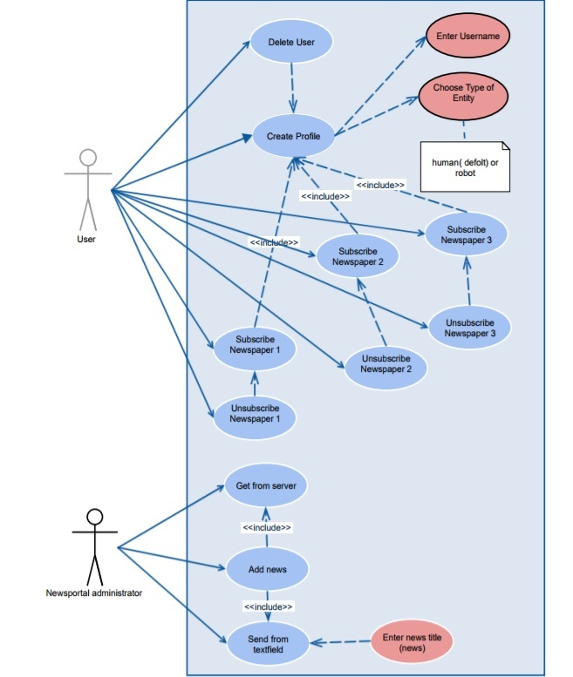

Slide 5
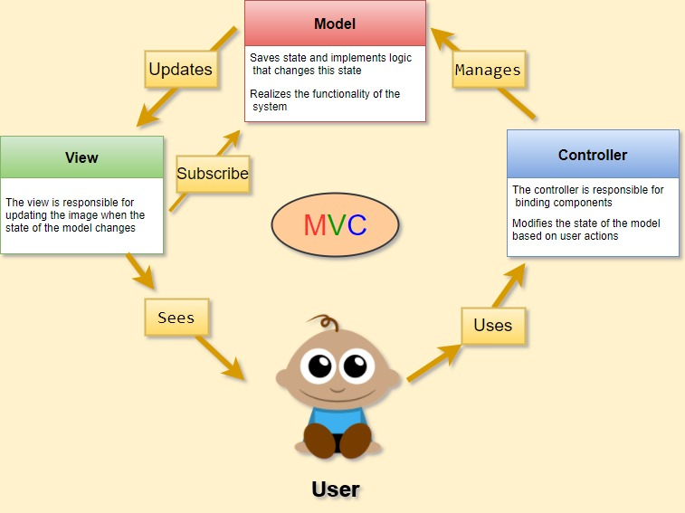

Slide 6
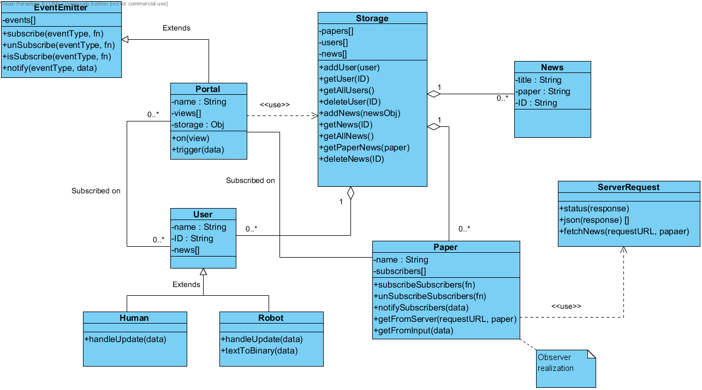

Slide 7
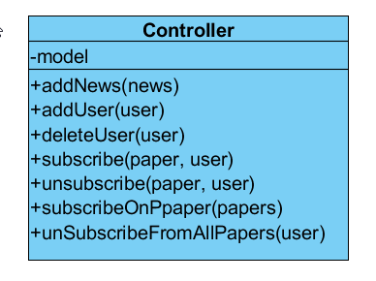

Slide 8
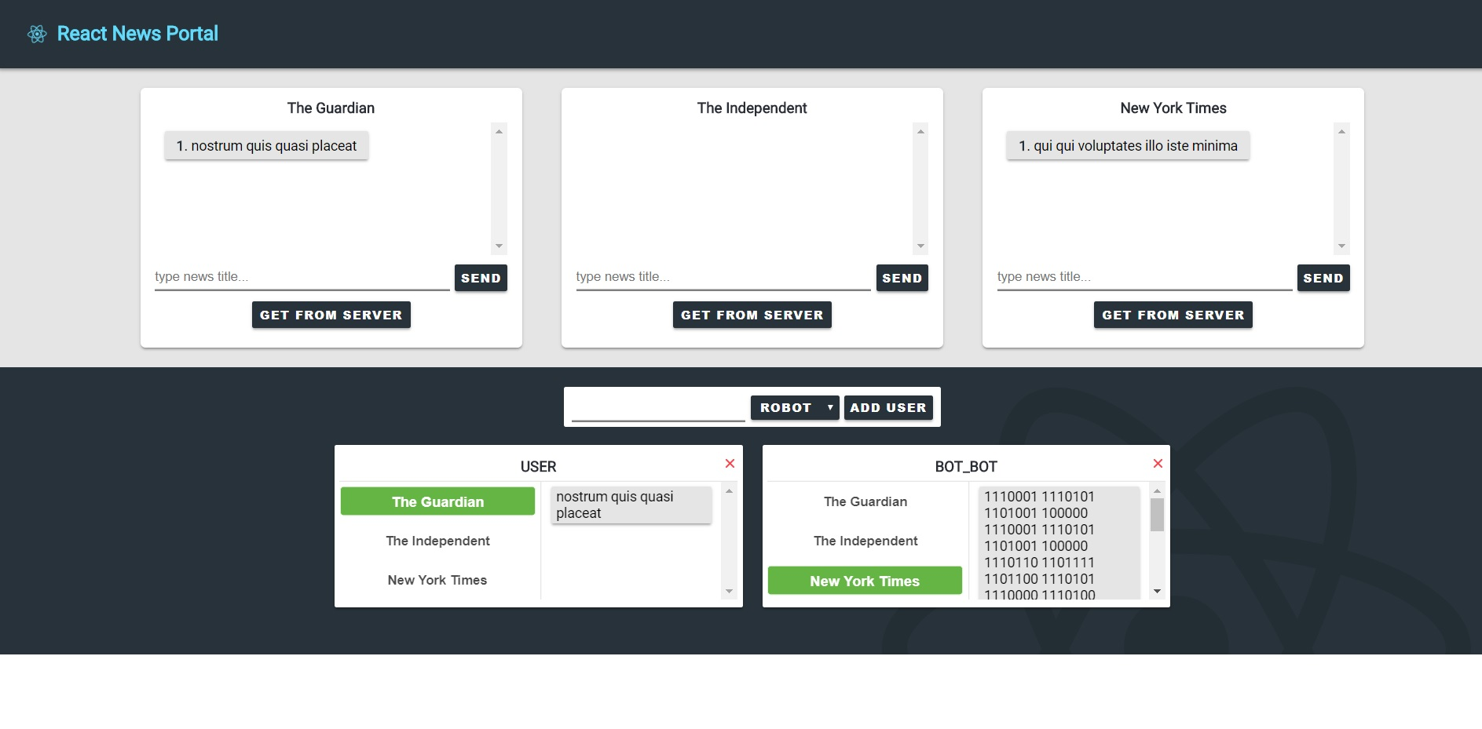

Slide 9
Developers: Igor kurchenko Bogdan Makarenko Dmytro Soloviov Galina Bartkova

